Slide 1
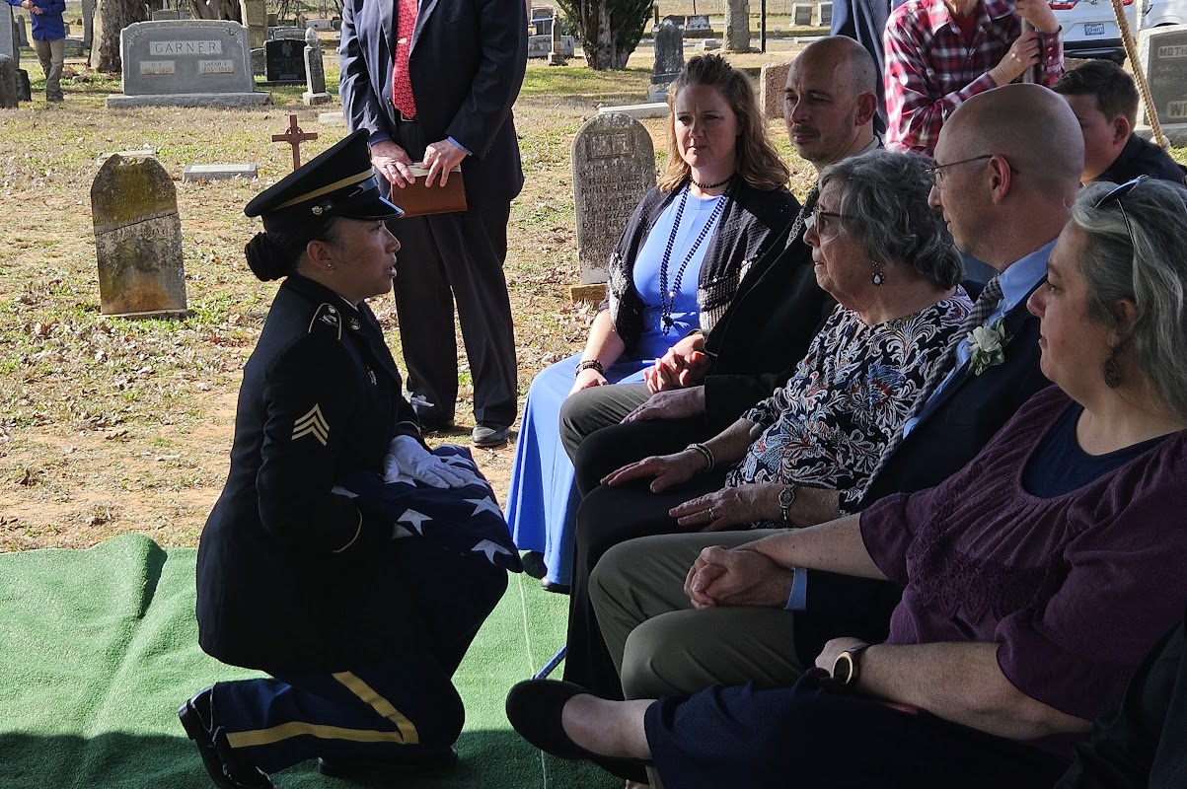
“It is better to go to a house of mourning…”

Slide 2
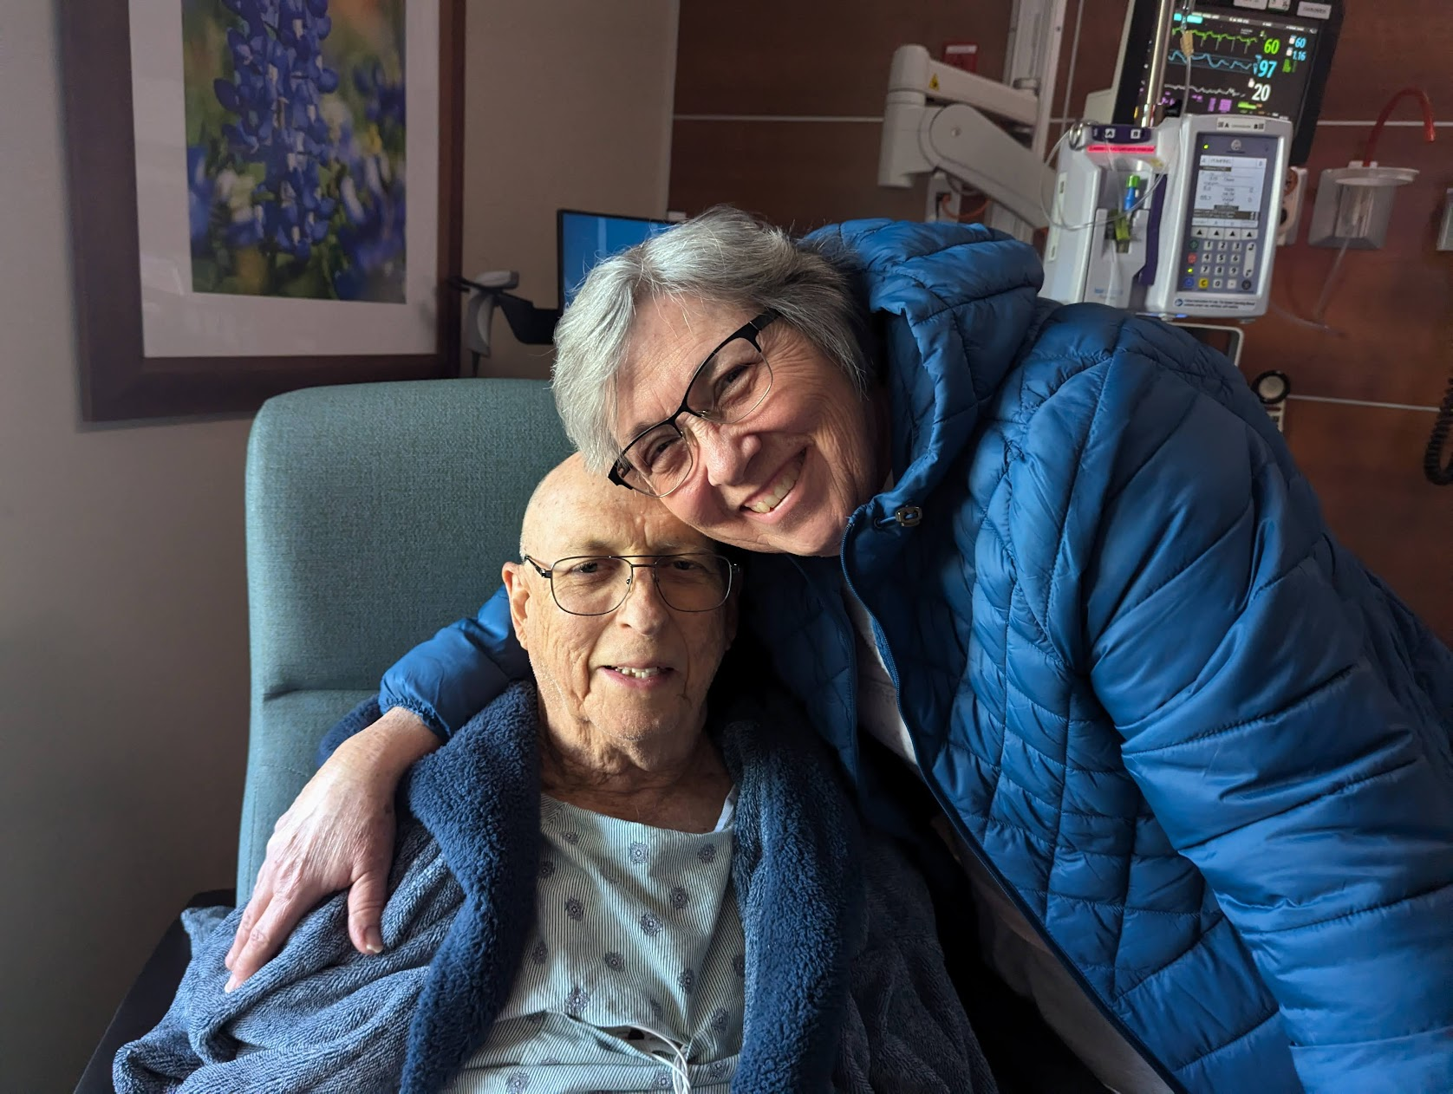
“It is better to go to a house of mourning…”
Russell and Marilyn Watson

Slide 3
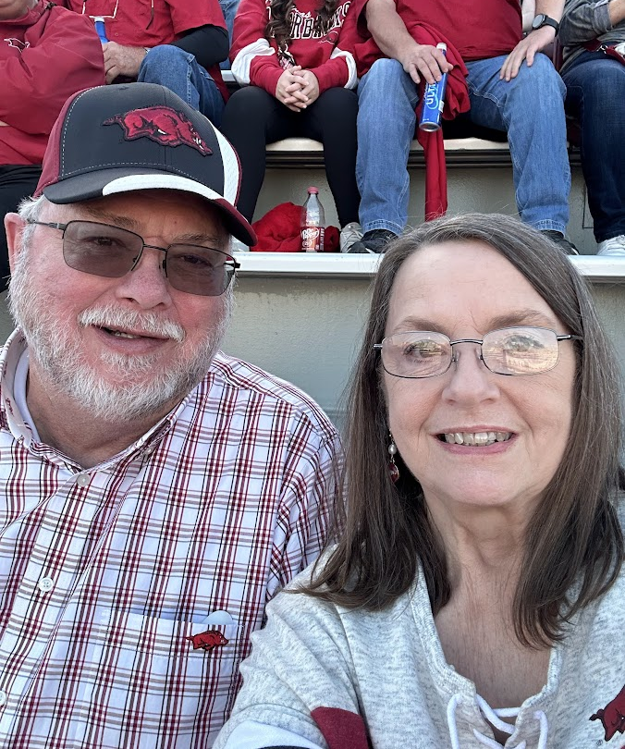
“It is better to go to a house of mourning…”
Nicky and Judy Broomas

Slide 4
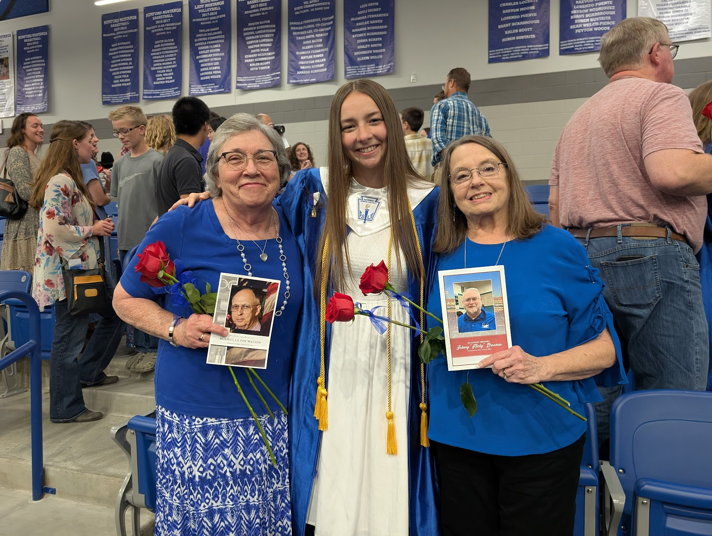
“It is better to go to a house of mourning…”
Allie Watson

Slide 5
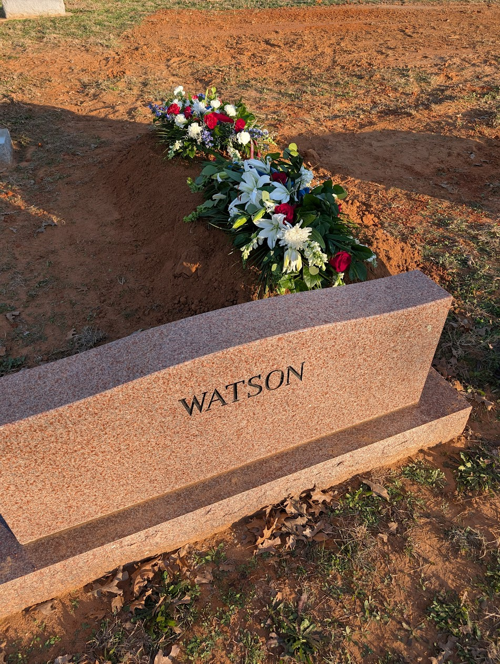
“It is better to go to a house of mourning…”
Death humbles us.

Slide 6
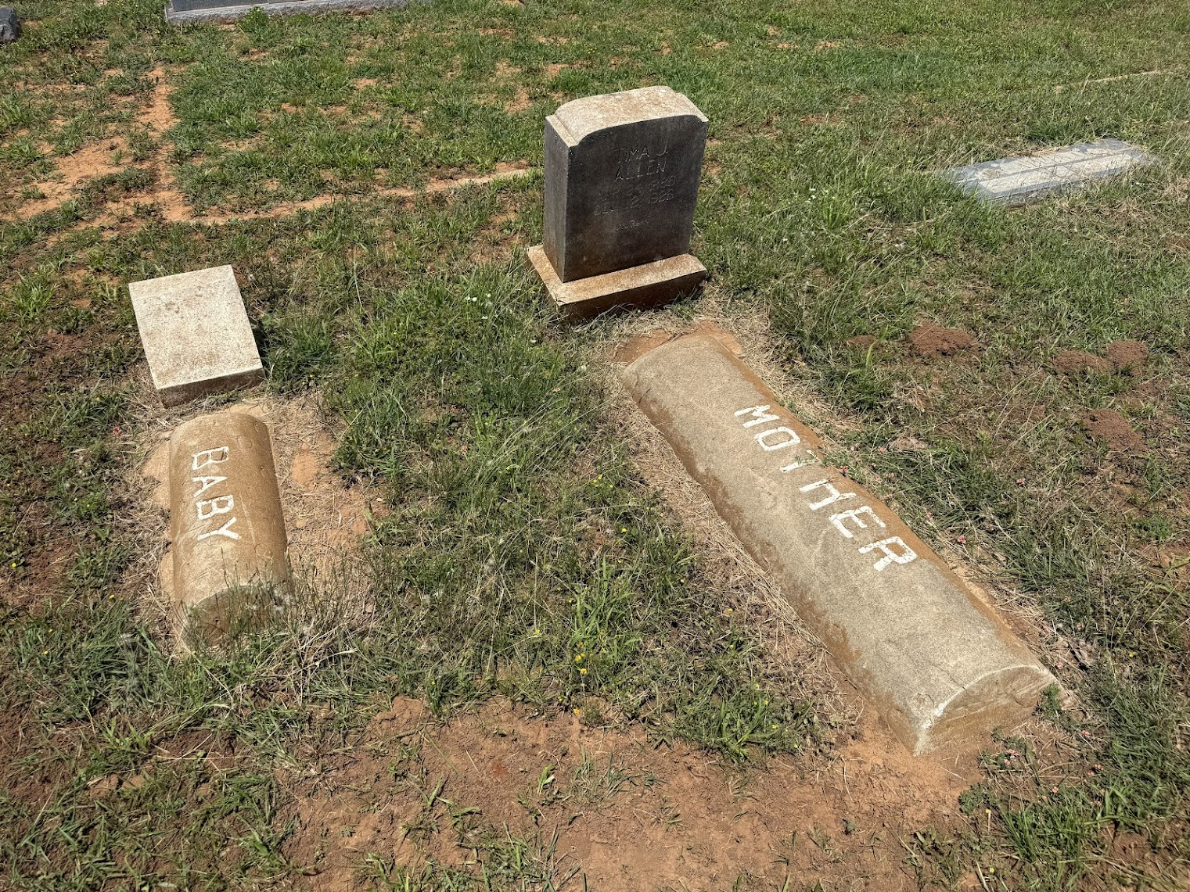

Slide 7
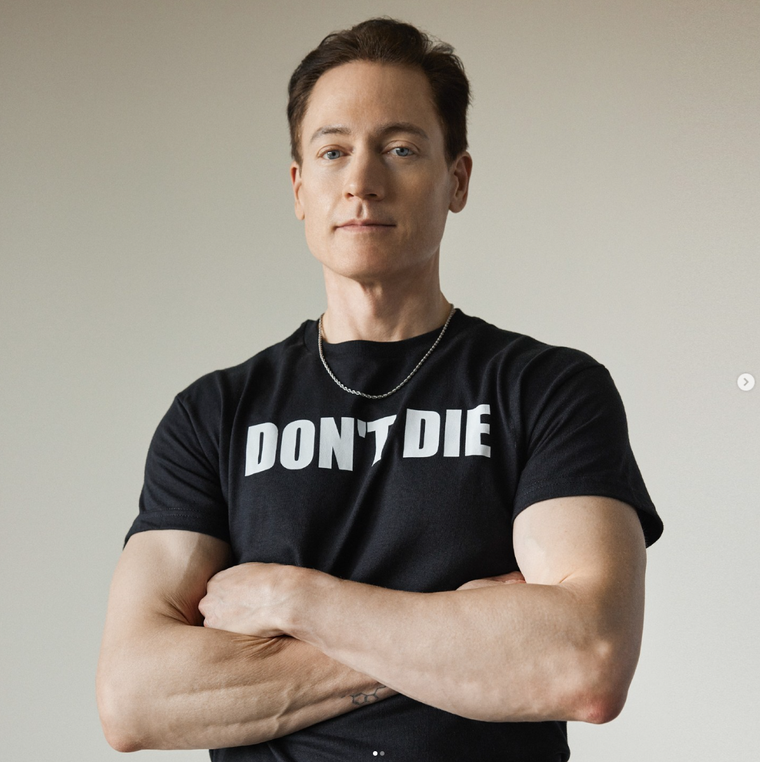
Bryan Johnson

Slide 8

“Bryan Johnson is the world's most measured human. Johnson sold his company, Braintree Venmo, to PayPal for $800m in 2013. Through his Project Blueprint, Johnson has achieved metabolic health equal to the top 1.5% of 18 year olds, inflammation 66% lower than the average 10 year old, and reduced his speed of aging by the equivalent of 31 years.” (https://www.youtube.com/@BryanJohnson)

Slide 9
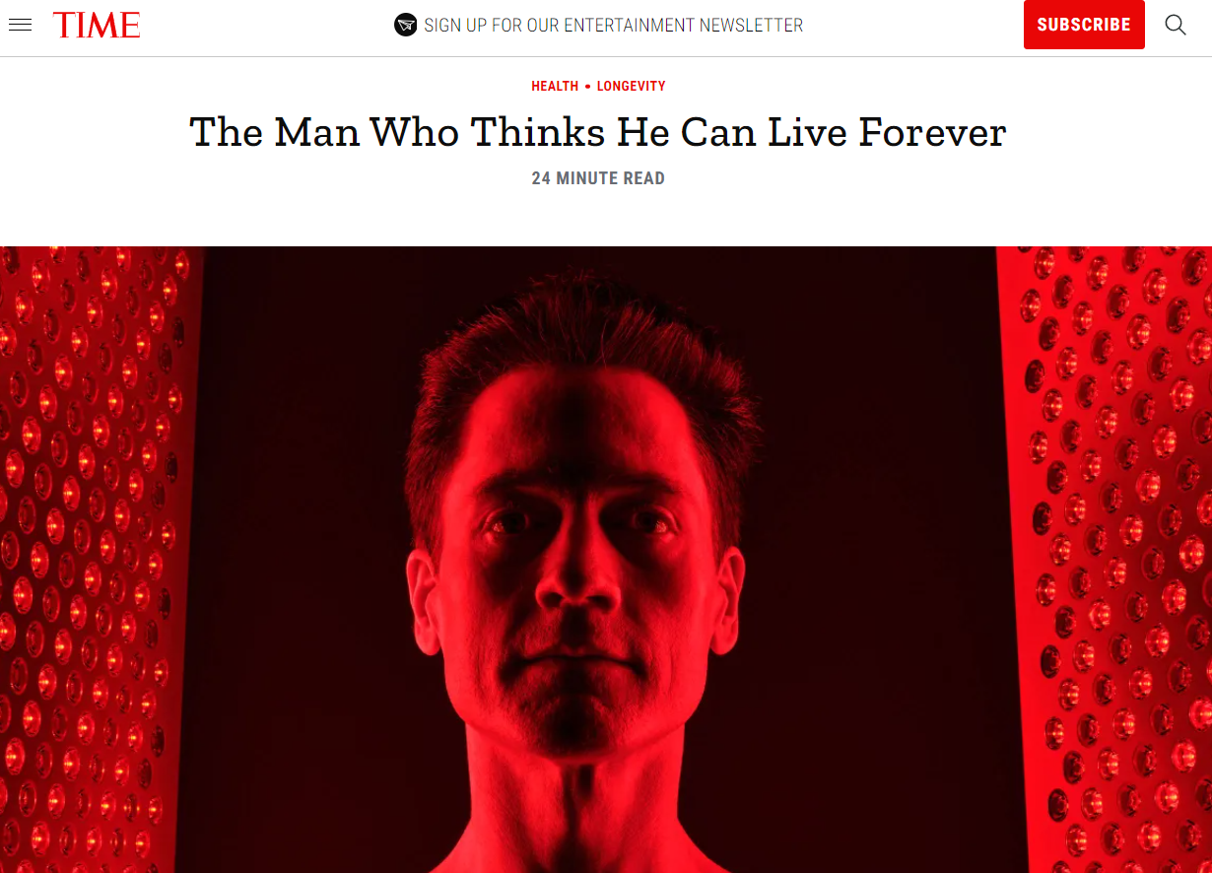
“Johnson’s quest is not just about staying rested or maintaining muscle tone. It’s about turning his whole body over to an anti-aging algorithm. He believes death is optional. He plans never to do it.”
https://time.com/6315607/bryan-johnsons-quest-for-immortality/

Slide 10
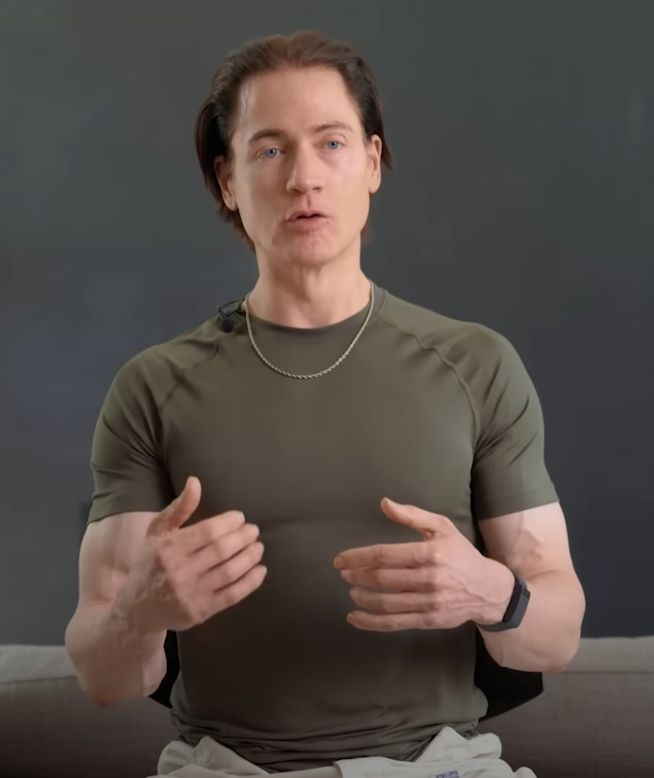
“We know this is powerful about humans. When one human does something, like the 4-minute-mile or first flight, so many other people can do it. It’s just one demonstration that’s needed to kick off an entire process. And that’s what I think we’ve done, is just a proof of concept that we can meaningfully control our aging.”
YouTube: Bryan Johnson lives by one rule: “Don’t die”
The Hard Reset Interview

Slide 11
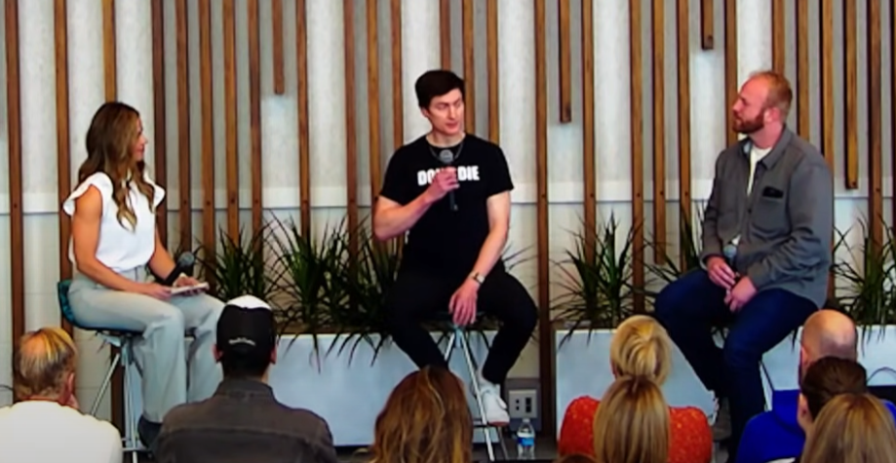
“If the future could talk to us, what they might say is that we have reached a point of technological and medical progress where death is no longer inevitable, or at least, we might be able to radically extend how long and how well we live.”
YouTube: Watch These 39 Minutes If You Want To Live To 200+

Slide 12

https://blueprint.bryanjohnson.com/

Slide 13
“It is better to go to a house of mourning…”
Death humbles us.
Death prompts us to take action NOW.

Slide 14
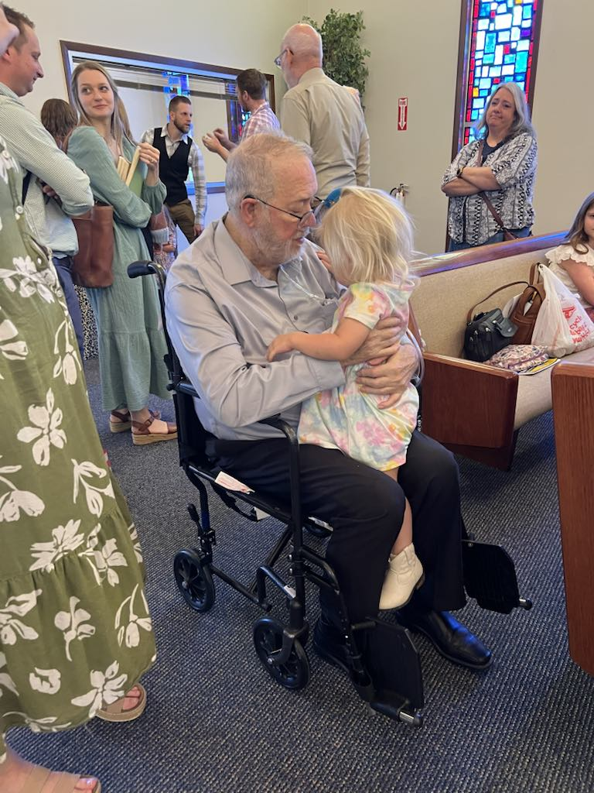
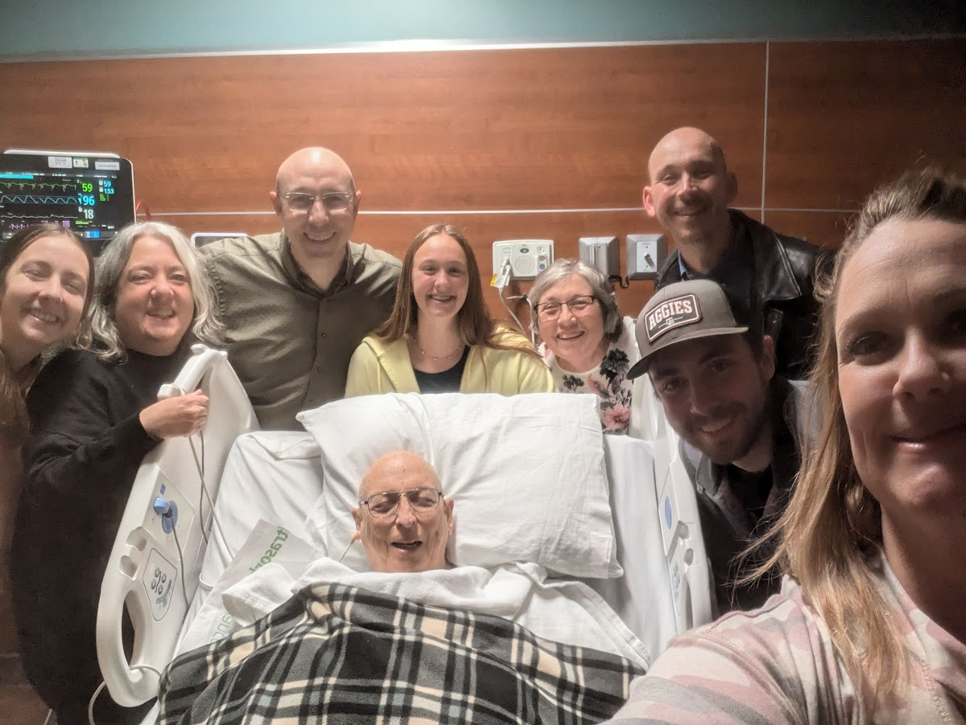
“It is better to go to a house of mourning…”

Slide 15
“It is better to go to a house of mourning…”
Death humbles us.
Death prompts us to take action NOW.
Death focuses us.

Slide 16
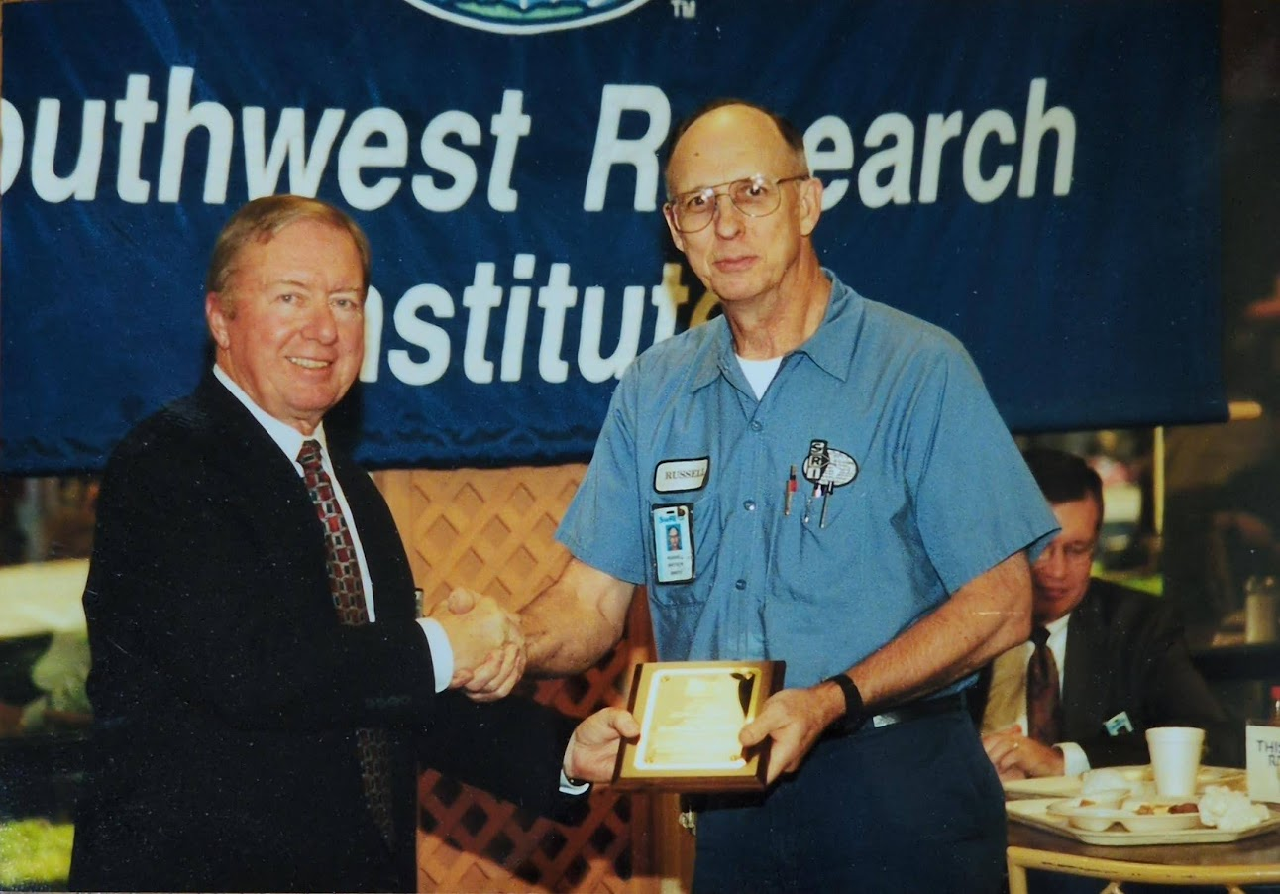
“It is better to go to a house of mourning…”

Slide 17
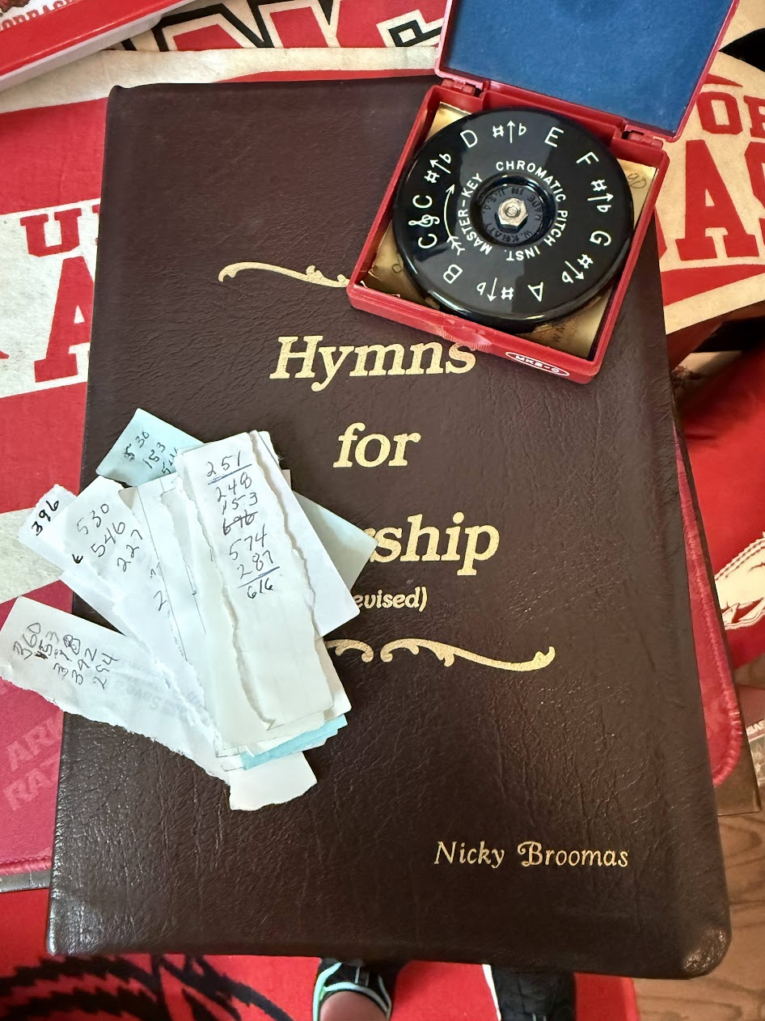
“It is better to go to a house of mourning…”

Slide 18
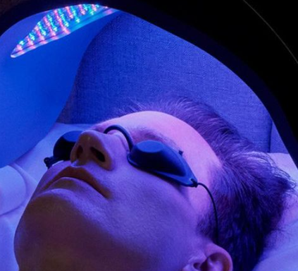
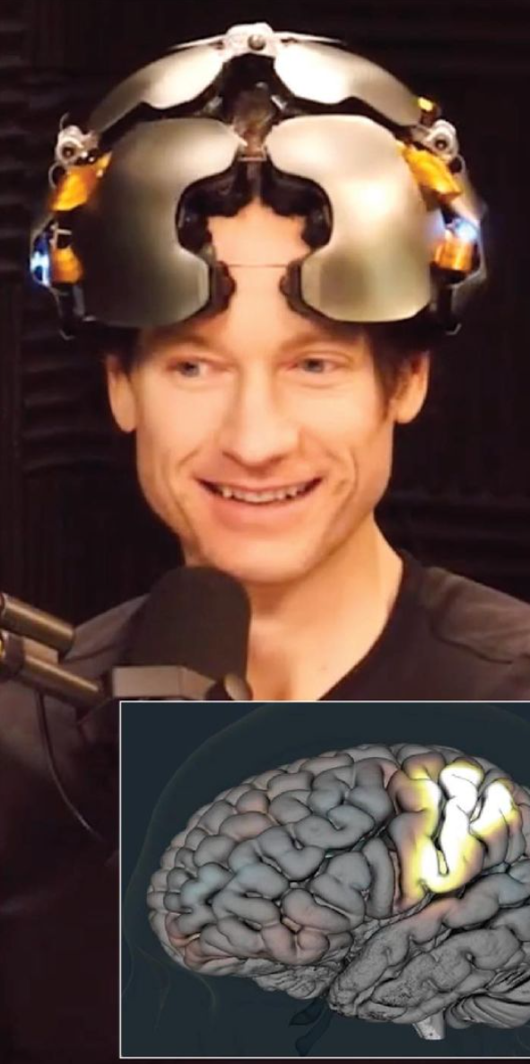
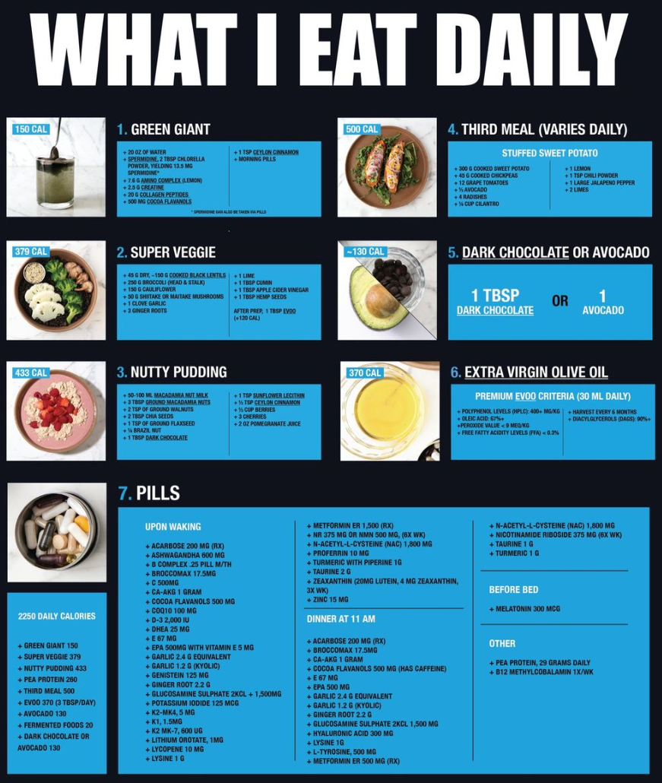
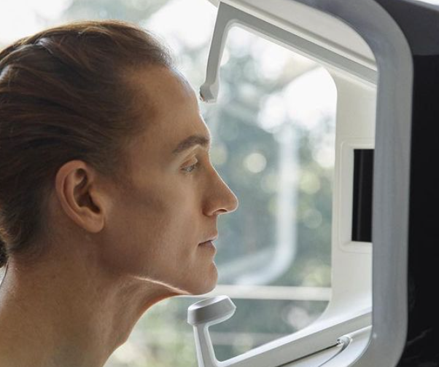

Slide 19
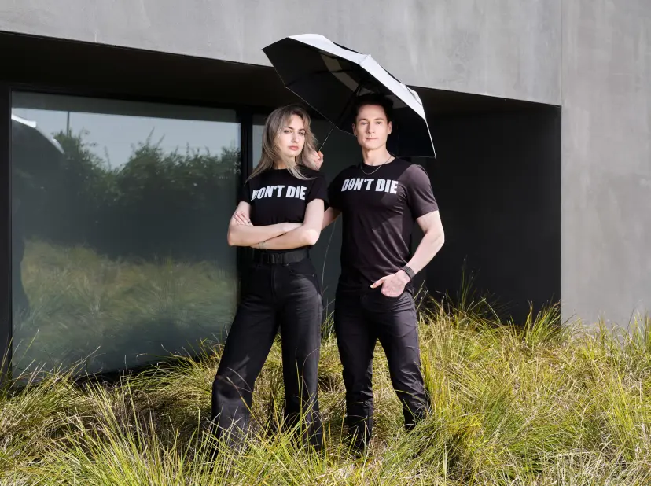
“The reasons include: eating dinner at 11:30 a.m., no sunny vacations, bed at 8:30pm, no small talk, always sleeping alone, and, of course, ‘they’re not my number one priority.’”
https://time.com/6315607/bryan-johnsons-quest-for-immortality/

Slide 20
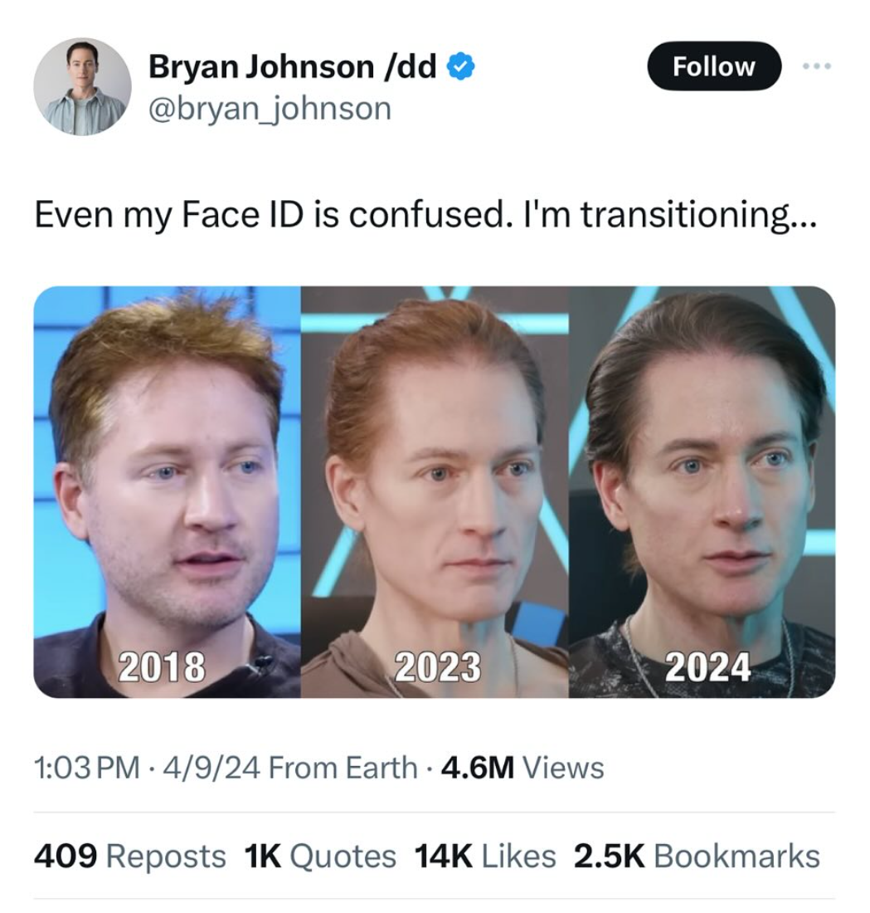

Slide 21
“It is better to go to a house of mourning…”
Death humbles us.
Death prompts us to take action NOW.
Death focuses us.
Death causes us to turn to God’s promises for comfort.

Slide 22
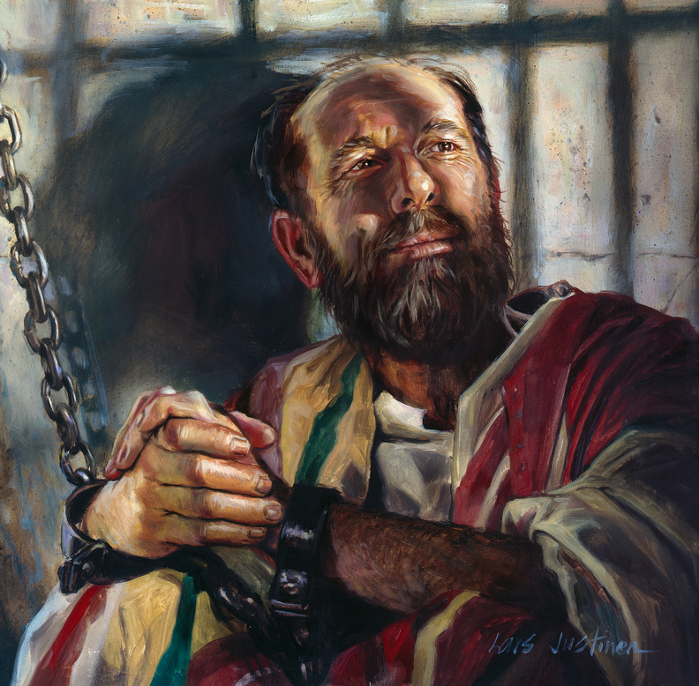
Two different philosophies:
Bryan Johnson
The apostle Paul
“Don’t die.”
dontdie.bryanjohnson.com
“to die is gain”
Philippians 1:21

