Slide 1
Marriage,
Divorce,
& Remarriage
(Part 1)

Slide 2
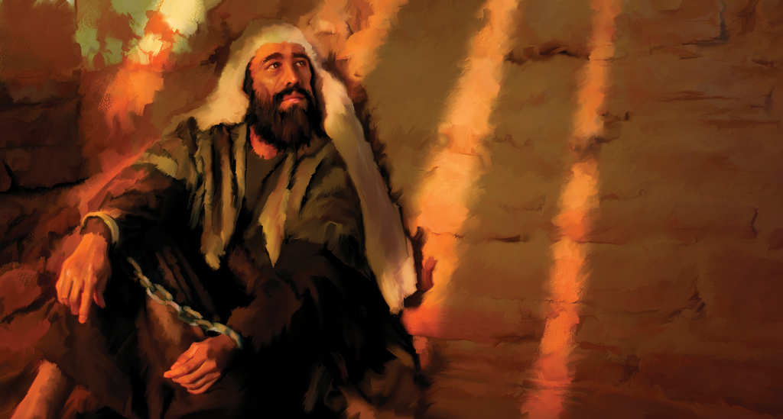
“For Herod himself had sent and had John arrested and bound in prison on account of Herodias, the wife of his brother Philip, because he had married her. For John had been saying to Herod, ‘It is not lawful for you to have your brother’s wife.’ Herodias had a grudge against him and wanted to put him to death…”
(Mark 6:17–19)

Slide 3
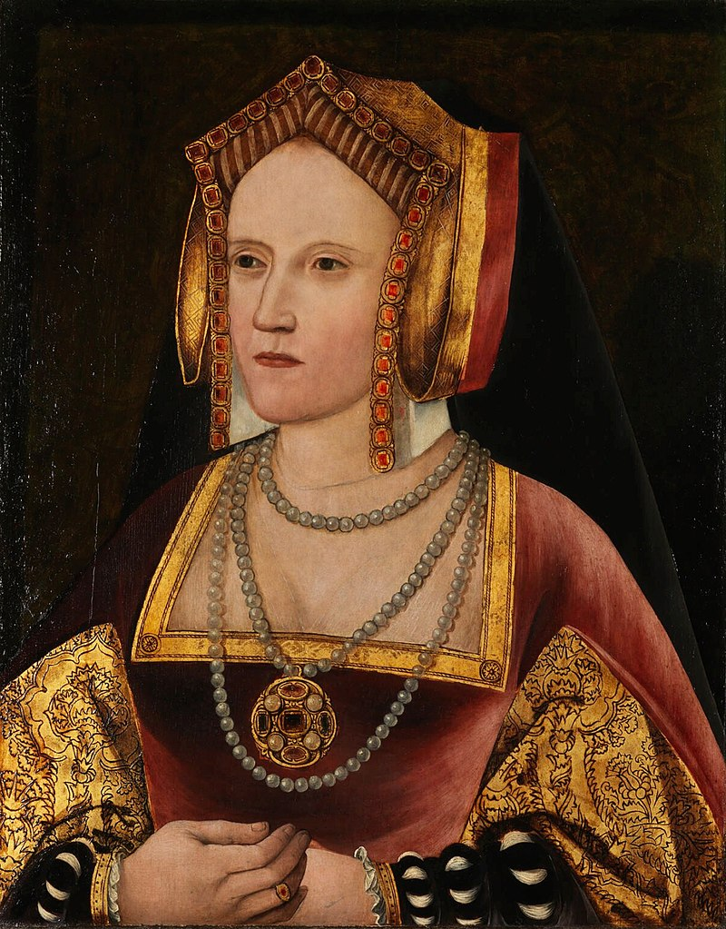
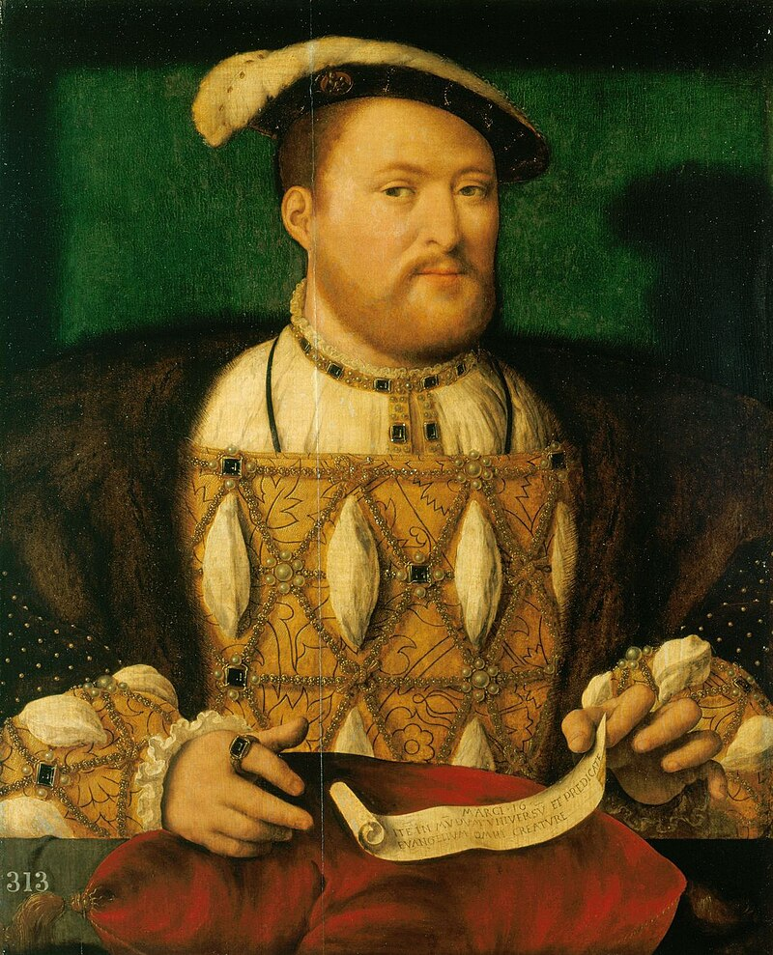
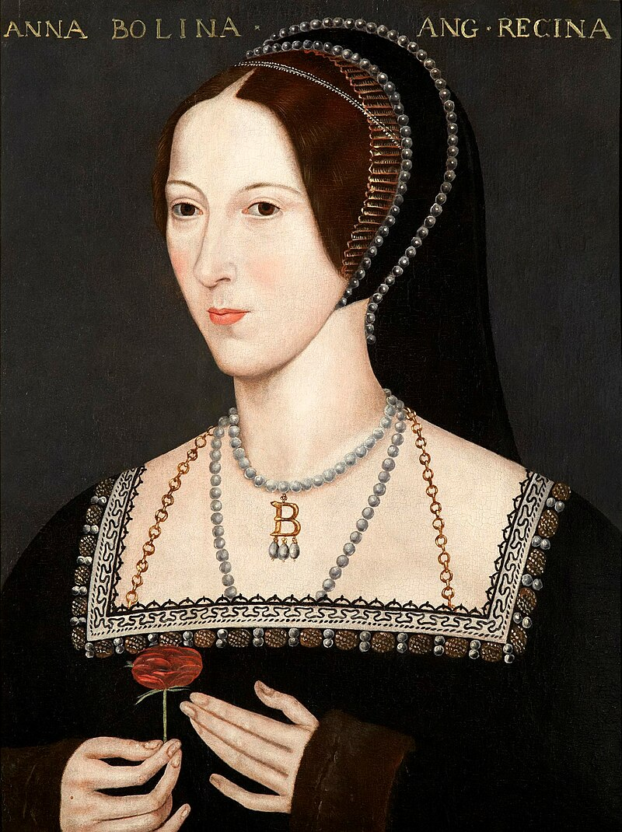
Catherine of Aragon
Henry VIII
Anne Boleyn

Slide 4
Genesis 2:18, 22-24 (NASB-95)
“(18) Then the LORD God said, ‘It is not good for the man to be alone; I will make him a helper suitable for him.’”
“(22) The LORD God fashioned into a woman the rib which He had taken from the man, and brought her to the man. (23) The man said, ‘This is now bone of my bones, And flesh of my flesh; She shall be called Woman, Because she was taken out of Man.’ (24) For this reason a man shall leave his father and his mother, and be joined to his wife; and they shall become one flesh.”

Slide 5
The Bible doesn’t always use the word “married” to refer to marriage. It often uses a descriptive phrase.
Genesis 2:24: “For this reason a man shall leave his father and his mother, and be joined to his wife; and they shall become one flesh.”
Deuteronomy 24:2: “becomes another man’s [wife]”
Deut. 7:3: “give your daughters…take their daughters”
Ezekiel 16:8: “you became Mine”
I Cor. 7:2: “have his own wife…have her own husband”
Romans 7:3: “she is joined to another man”

Slide 6




Old Testament Hebrew
is
issa
“man”
“husband”
“woman”
“wife”
New Testament Greek
aner
gyne
“man”
“husband”
“woman”
“wife”

Slide 7
issa
Genesis 2:22 – 3:2 (NASB-95)
“(22) The LORD God fashioned into a woman the rib which He had taken from the man, and brought her to the man. (23) The man said, ‘This is now bone of my bones, And flesh of my flesh; She shall be called Woman, Because she was taken out of Man.’ (24) For this reason a man shall leave his father and his mother, and be joined to his wife; and they shall become one flesh. (25) And the man and his wife were both naked and were not ashamed. (3:1) Now the serpent was more crafty than any beast of the field which the LORD God had made. And he said to the woman, ‘Indeed, has God said, ‘You shall not eat from any tree of the garden’?’ (2) The woman said to the serpent, ‘From the fruit of the trees of the garden we may eat…’

Slide 8
issa
Genesis 2:22 – 3:2 (NASB-95)
“(22) The LORD God fashioned into a woman the rib which He had taken from the man, and brought her to the man. (23) The man said, ‘This is now bone of my bones, And flesh of my flesh; She shall be called Woman, Because she was taken out of Man.’ (24) For this reason a man shall leave his father and his mother, and be joined to his wife; and they shall become one flesh. (25) And the man and his wife were both naked and were not ashamed. (3:1) Now the serpent was more crafty than any beast of the field which the LORD God had made. And he said to the woman, ‘Indeed, has God said, ‘You shall not eat from any tree of the garden’?’ (2) The woman said to the serpent, ‘From the fruit of the trees of the garden we may eat…’

Slide 9
Old Testament Hebrew
is
issa
“man”
“husband”
“woman”
“wife”
New Testament Greek
aner
gyne
“man”
“husband”
“woman”
“wife”

Slide 10
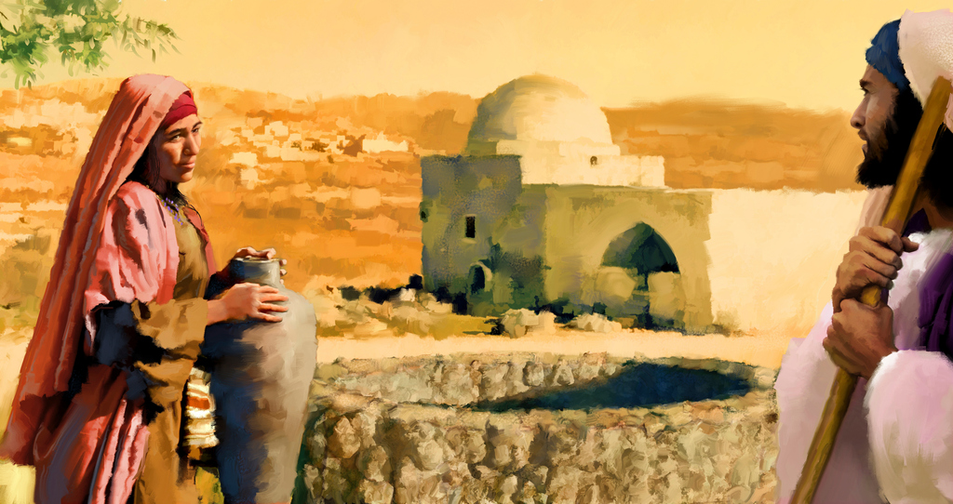
aner
“He said to her, ‘Go, call your husband and come here.’ The woman answered and said, ‘I have no husband.’ Jesus said to her, ‘You have correctly said, ‘I have no husband’; for you have had five husbands, and the one whom you now have is not your husband; this you have said truly.’”
(John 4:16 –18)

Slide 11
Words can refer figuratively to the past or future.
Luke 2:11: “for today in the city of David there has been born for you a Savior, who is Christ the Lord.”
Deuteronomy 22:23-24: “If there is a girl who is a virgin engaged to a man, and another man finds her in the city and lies with her…he has violated his neighbor's wife.”
(Prolepsis)

Slide 12
Words can refer figuratively to the past or future.
Ex. 7:10, 12: “Aaron threw his staff down before Pharaoh and his servants, and it became a serpent.…For each one threw down his staff and they turned into serpents. But Aaron's staff swallowed up their staffs.”
John 9:17: “So they said to the blind man, ‘What do you say about Him, since He opened your eyes?’”
II Samuel 11:26: “Now when the wife of Uriah heard that Uriah her husband was dead, she mourned for her husband.”
12:10: “you have despised Me and have taken the wife of Uriah the Hittite to be your wife.”
(Adjournment)

Slide 13
“For Herod himself had sent and had John arrested and bound in prison on account of Herodias, the wife of his brother Philip, because he had married her. For John had been saying to Herod, ‘It is not lawful for you to have your brother’s wife.’ Herodias had a grudge against him and wanted to put him to death…”
(Mark 6:17–19)

Slide 14
Romans 7:1-4 (NASB-95)
“(1) Or do you not know, brethren (for I am speaking to those who know the law), that the law has jurisdiction over a person as long as he lives?”
“(2) For the married woman is bound by law to her husband while he is living; but if her husband dies, she is released from the law concerning the husband. (3) So then, if while her husband is living she is joined to another man, she shall be called an adulteress; but if her husband dies, she is free from the law, so that she is not an adulteress though she is joined to another man.”
“(4) Therefore, my brethren, you also were made to die to the Law through the body of Christ, so that you might be joined to another, to Him who was raised from the dead, in order that we might bear fruit for God.”

Slide 15
Romans 7:2-3 (NASB-95)
“(2) For the married woman is bound by law to her husband while he is living; but if her husband dies, she is released from the law concerning the husband. (3) So then, if while her husband is living she is joined to another man, she shall be called an adulteress; but if her husband dies, she is free from the law, so that she is not an adulteress though she is joined to another man.”

Slide 16
Romans 7:2-3 (NASB-95)
“(2) For the married woman is bound by law to her husband while he is living; but if her husband dies, she is released from the law concerning the husband. (3) So then, if while her husband is living she is joined to another man, she shall be called an adulteress; but if her husband dies, she is free from the law, so that she is not an adulteress though she is joined to another man.”
Married

Slide 17
Romans 7:2-3 (NASB-95)
“(2) For the married woman is bound by law to her husband while he is living; but if her husband dies, she is released from the law concerning the husband. (3) So then, if while her husband is living she is joined to another man, she shall be called an adulteress; but if her husband dies, she is free from the law, so that she is not an adulteress though she is joined to another man.”
Bound by law
Married

Slide 18
Romans 7:2-3 (NASB-95)
“(2) For the married woman is bound by law to her husband while he is living; but if her husband dies, she is released from the law concerning the husband. (3) So then, if while her husband is living she is joined to another man, she shall be called an adulteress; but if her husband dies, she is free from the law, so that she is not an adulteress though she is joined to another man.”

Slide 19
Romans 7:2-3 (NASB-95)
“(2) For the married woman is bound by law to her husband while he is living; but if her husband dies, she is released from the law concerning the husband. (3) So then, if while her husband is living she is joined to another man, she shall be called an adulteress; but if her husband dies, she is free from the law, so that she is not an adulteress though she is joined to another man.”
Bound by law
Married

Slide 20
Romans 7:2-3 (NASB-95)
“(2) For the married woman is bound by law to her husband while he is living; but if her husband dies, she is released from the law concerning the husband. (3) So then, if while her husband is living she is joined to another man, she shall be called an adulteress; but if her husband dies, she is free from the law, so that she is not an adulteress though she is joined to another man.”
Bound by law
Married
Adulteress

Slide 21
Romans 7:2-3 (NASB-95)
“(2) For the married woman is bound by law to her husband while he is living; but if her husband dies, she is released from the law concerning the husband. (3) So then, if while her husband is living she is joined to another man, she shall be called an adulteress; but if her husband dies, she is free from the law, so that she is not an adulteress though she is joined to another man.”
Married

Slide 22
Romans 7:2-3 (NASB-95)
“(2) For the married woman is bound by law to her husband while he is living; but if her husband dies, she is released from the law concerning the husband. (3) So then, if while her husband is living she is joined to another man, she shall be called an adulteress; but if her husband dies, she is free from the law, so that she is not an adulteress though she is joined to another man.”
Bound by law
Married

Slide 23
The Bible doesn’t always use the word “married” to refer to marriage. It often uses a descriptive phrase.
Genesis 2:24: “For this reason a man shall leave his father and his mother, and be joined to his wife; and they shall become one flesh.”
Deuteronomy 24:2: “becomes another man’s [wife]”
Deut. 7:3: “give your daughters…take their daughters”
Ezekiel 16:8: “you became Mine”
I Cor. 7:2: “have his own wife…have her own husband”
Romans 7:3: “she is joined to another man”

Slide 24
Romans 7:2-3 (NASB-95)
“(2) For the married woman is bound by law to her husband while he is living; but if her husband dies, she is released from the law concerning the husband. (3) So then, if while her husband is living she is joined to another man, she shall be called an adulteress; but if her husband dies, she is free from the law, so that she is not an adulteress though she is joined to another man.”
“joined” = married
Bound by law
Married

Slide 25
I Corinthians 7:39 (NASB-95)
“A wife is bound as long as her husband lives; but if her husband is dead, she is free to be married to whom she wishes, only in the Lord.”
Bound by law
Married

Slide 26
I Corinthians 7:39 (NASB-95)
“A wife is bound as long as her husband lives; but if her husband is dead, she is free to be married to whom she wishes, only in the Lord.”
Free to be married

Slide 27
I Corinthians 7:39 (NASB-95)
This defines “bound” by contrast:
Husband is alive
“bound”
Husband is dead
“free to be married”
So what does “bound” mean?
It means she is NOT “free to be married.”

Slide 28
Mark 10:11-12 (NASB-95)
“(11) And He said to them, ‘Whoever divorces his wife and marries another woman commits adultery against her; (12) and if she herself divorces her husband and marries another man, she is committing adultery.’”
Bound by law
Married

Slide 29
Mark 10:11-12 (NASB-95)
“(11) And He said to them, ‘Whoever divorces his wife and marries another woman commits adultery against her; (12) and if she herself divorces her husband and marries another man, she is committing adultery.’”
Bound by law
Married

Slide 30
Mark 10:11-12 (NASB-95)
“(11) And He said to them, ‘Whoever divorces his wife and marries another woman commits adultery against her; (12) and if she herself divorces her husband and marries another man, she is committing adultery.’”
Commits adultery
Bound by law
Married

Slide 31
Mark 10:11-12 (NASB-95)
“(11) And He said to them, ‘Whoever divorces his wife and marries another woman commits adultery against her; (12) and if she herself divorces her husband and marries another man, she is committing adultery.’”
Commits adultery
Bound by law
Married
Bound by law

Slide 32
Mark 10:11-12 (NASB-95)
“(11) And He said to them, ‘Whoever divorces his wife and marries another woman commits adultery against her; (12) and if she herself divorces her husband and marries another man, she is committing adultery.’”
she is committing adultery
Bound by law
Married
Bound by law

Slide 33
Bound by law
Married
Bound by law

Slide 34
Luke 16:18 (NASB-95)
“Everyone who divorces his wife and marries another commits adultery, and he who marries one who is divorced from a husband commits adultery.”
Bound by law
Married
Bound by law

Slide 35
Luke 16:18 (NASB-95)
“Everyone who divorces his wife and marries another commits adultery, and he who marries one who is divorced from a husband commits adultery.”
Commits adultery
Bound by law
Married
Bound by law

Slide 36
Luke 16:18 (NASB-95)
“Everyone who divorces his wife and marries another commits adultery, and he who marries one who is divorced from a husband commits adultery.”
Commits adultery
Bound by law
Married
Bound by law

Slide 37
Luke 16:18 (NASB-95)
“Everyone who divorces his wife and marries another commits adultery, and he who marries one who is divorced from a husband commits adultery.”
Commits adultery
Commits adultery
Commits adultery
Commits adultery
Bound by law
Married
Married
Bound by law

Slide 38
Matthew 19:9 (NASB-95)
“And I say to you, whoever divorces his wife,
except for immorality,
and marries another woman commits adultery.”

Slide 39
Matthew 19:9
ASV: except for fornication
NASB (1977): except for fornication
NASB (1995): except for immorality
NASB (2020): except for sexual immorality
KJV: except it be for fornication
NKJV: except for sexual immorality
ESV: except for sexual immorality

Slide 40
Examples of how the Holy Spirit uses this Greek word:
I Corinthians 6:13: “The body is not meant for sexual immorality, but for the Lord, and the Lord for the body.”
6:18: “Flee from sexual immorality. Every other sin a person commits is outside the body, but the sexually immoral person sins against his own body.”
7:2: “But because of the temptation to sexual immorality, each man should have his own wife and each woman her own husband.”
(ESV)

Slide 41
Matthew 19:9 (ESV)
“And I say to you: whoever divorces his wife,
except for sexual immorality,
and marries another, commits adultery.”

Slide 42
Matthew 19:9 (ESV)
“And I say to you: whoever divorces his wife,
except for sexual immorality,
and marries another, commits adultery.”
Some manuscripts add: “and whoever marries her who is divorced commits adultery.”

Slide 43
Matthew 19:9 (ESV)
“And I say to you: whoever divorces his wife,
except for sexual immorality,
and marries another, commits adultery.”
Bound by law
Married
Bound by law

Slide 44
Matthew 19:9 (ESV)
“And I say to you: whoever divorces his wife,
except for sexual immorality,
and marries another, commits adultery.”
Commits adultery
Bound by law
Married
Bound by law

Slide 45
Matthew 19:9 (ESV)
“And I say to you: whoever divorces his wife,
except for sexual immorality,
and marries another, commits adultery.”
Divorced his wife for sexual immorality
Bound by law
Married

Slide 46
Matthew 19:9 (ESV)
“And I say to you: whoever divorces his wife,
except for sexual immorality,
and marries another, commits adultery.”
Divorced his wife for sexual immorality
Bound by law
Bound by law
Married
Bound by law

Slide 47
Matthew 5:32 (ESV)
“But I say to you that everyone who divorces his wife, except on the ground of sexual immorality, makes her commit adultery, and whoever marries a divorced woman commits adultery.”
Bound by law
Married
Bound by law

Slide 48
Matthew 5:32 (ESV)
“But I say to you that everyone who divorces his wife, except on the ground of sexual immorality, makes her commit adultery, and whoever marries a divorced woman commits adultery.”
Makes her commit adultery
Bound by law
Bound by law

Slide 49
Matthew 5:32 (ESV)
“But I say to you that everyone who divorces his wife, except on the ground of sexual immorality, makes her commit adultery, and whoever marries a divorced woman commits adultery.”
Divorces his wife on the ground of sexual immorality
Bound by law

Slide 50
Matthew 5:32 (ESV)
“But I say to you that everyone who divorces his wife, except on the ground of sexual immorality, makes her commit adultery, and whoever marries a divorced woman commits adultery.”
Divorces his wife on the ground of sexual immorality
Commits adultery
Commits adultery
Bound by law
Married

Slide 51
SIN and SATAN are the problems here, not God or His laws.

