Slide 1

HELPING MY KIDS HANDLE SOCIAL MEDIA

Slide 2
“When Alexis Spence was 11, she opened an Instagram account on her iPad without her parents knowing. As Alexis consumed more and more ‘thinspiration’ content, she began starving herself. By 15, she had developed a severe eating disorder and spent time in a residential treatment center as she battled anorexia and suicidal thoughts. Alexis survived, but still struggles with mental health issues and was not able to leave home for college.”
Dr. Jean M. Twenge. 10 Rules for Raising Kids in a High-Tech World.

Slide 3
“A blackmailer posing as a teen girl talked a 15-year-old Utah boy into sending nude pictures of himself on Snapchat. The user threatened to send screenshots of the images to his friends and family unless he paid $200. He was so devastated he took his own life.”
Dr. Jean M. Twenge. 10 Rules for Raising Kids in a High-Tech World.

Slide 4
Selena Rodriquez opened an Instagram account when she was 10 and before long was using it at all hours of the day and night. When she wasn’t on Instagram, she was on Snapchat. Several adult men asked her to send nude pictures and videos of herself. Selena was eventually hospitalized for depression and self-harm. At the age of 11, she died by suicide.”
Dr. Jean M. Twenge. 10 Rules for Raising Kids in a High-Tech World.

Slide 5
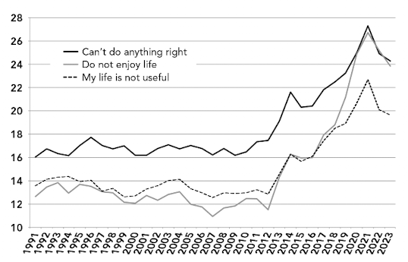
Symptoms of depression, U.S. teens, 1991−2023
Source: Monitoring the Future survey of 8th, 10th, and 12th graders
Jean M. Twenge, PhD. 10 Rules for Raising Kids in a High-Tech World

Slide 6
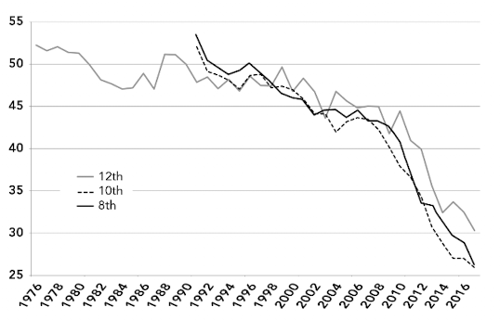
Percent of U.S. teens who get together with their friends
almost every day, 1976−2017
Source: Monitoring the Future survey of 8th, 10th, and 12th graders
Jean M. Twenge, PhD. 10 Rules for Raising Kids in a High-Tech World

Slide 7
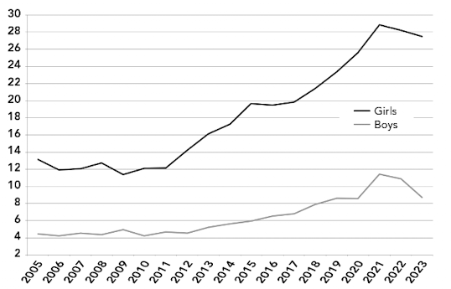
Rates of clinical-level depression, U.S. 12- to 17-year-olds, 2005−2023
Source: National Survey on Drug Use and Health
Jean M. Twenge, PhD. 10 Rules for Raising Kids in a High-Tech World

Slide 8
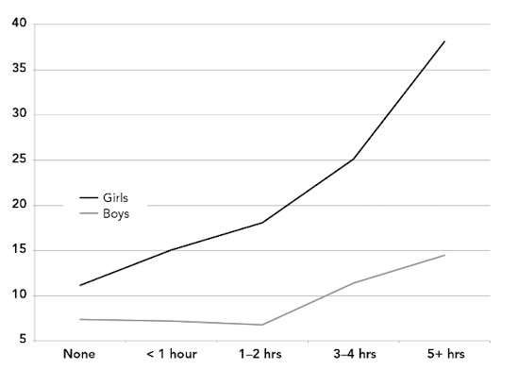
Social media use and depression, UK teens
Source: Kelly et al. (2019), Millennium Cohort Study
Jean M. Twenge, PhD. 10 Rules for Raising Kids in a High-Tech World

Slide 9
“When people cut back on social media for a few weeks, they end up happier and less depressed compared to those who keep using social media as they always have. A study of Danish families found that after two weeks with minimal access to screens, kids and teens were less angry and less depressed compared to a control group who did not change their screen use. These studies are experiments (also known as randomized controlled trials), the gold standard in science for showing causation because people are randomly assigned to either cut back on social media time or not, which equalizes extraneous factors. These studies mean social media causes depression, not just that the two are linked. In June 2024, the U.S. Surgeon General called for warning labels to be placed on social media to make parents aware of their potential harm to teens’ mental health.”
Dr. Jean M. Twenge. 10 Rules for Raising Kids in a High-Tech World.

Slide 10
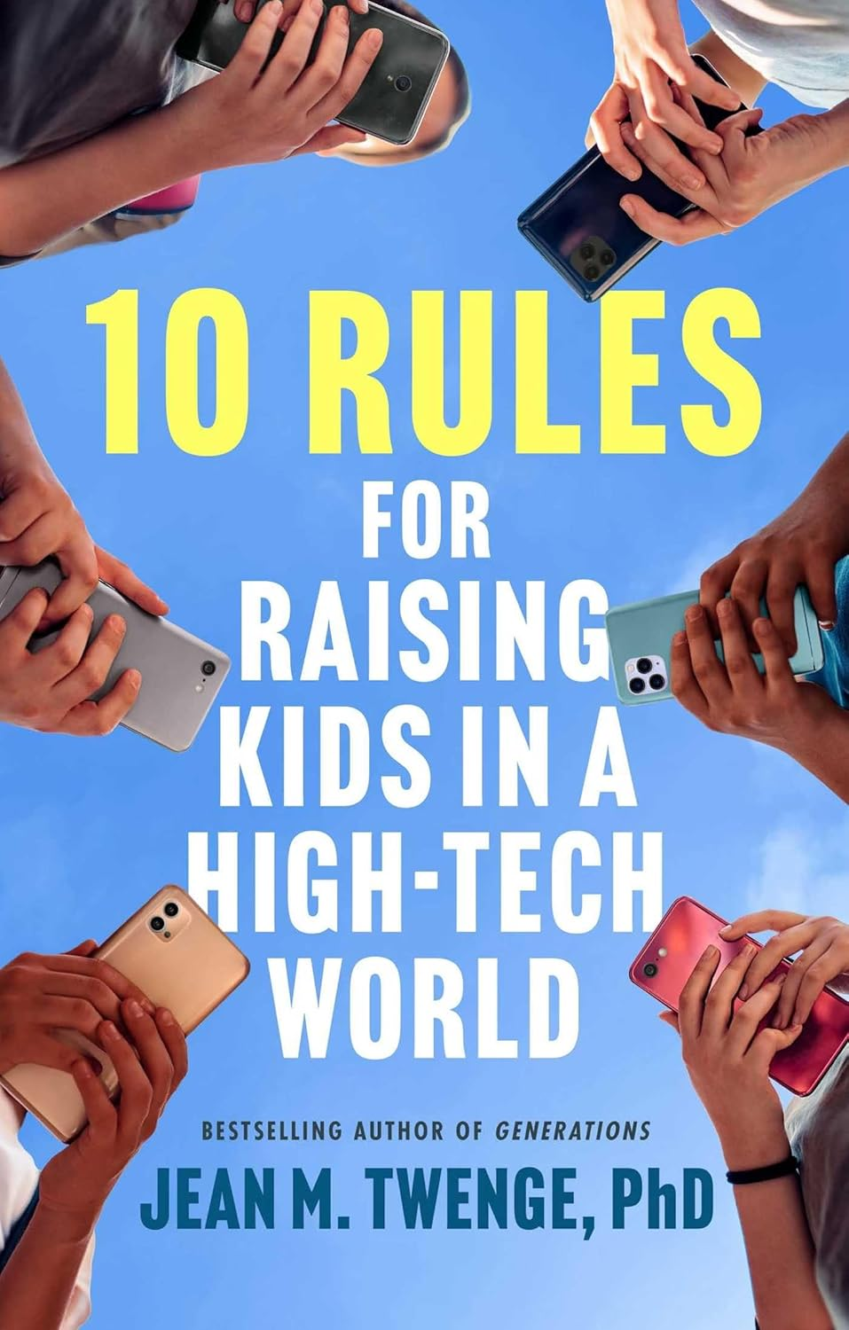

Slide 11
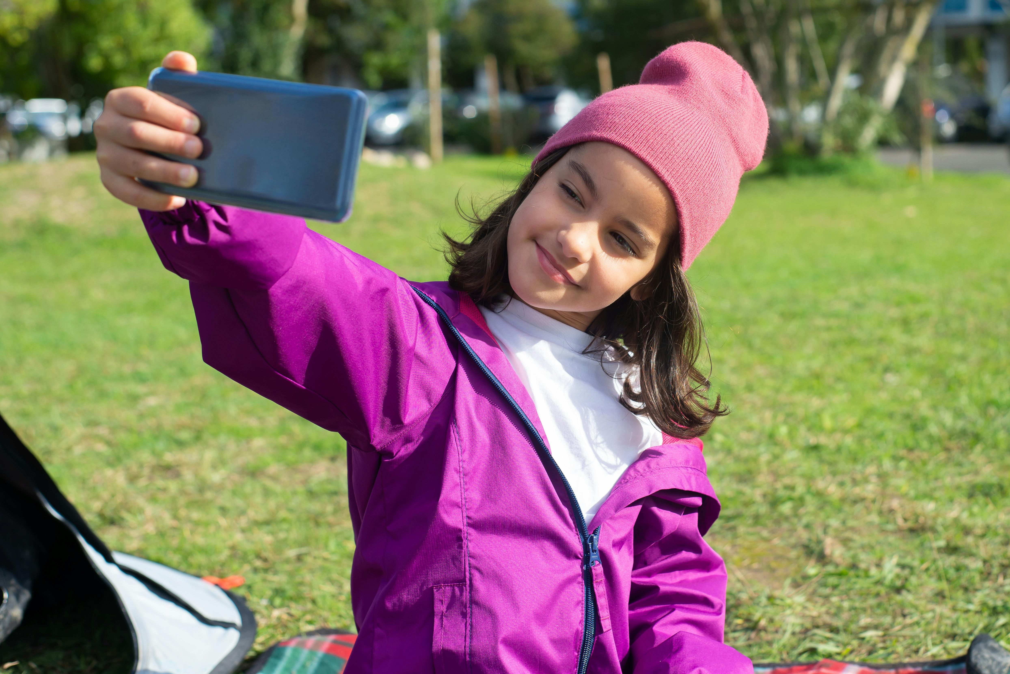
HELPING MY KIDS HANDLE SOCIAL MEDIA
Make sure your daughters and sons know how valuable they are.

Slide 12
HELPING MY KIDS HANDLE SOCIAL MEDIA
“Jordan, 15, says, ‘Nobody really slides up on your story unless you post something, like, really revealing…. If you post your face, they’ll just kind of like go past it. But if you like, post your [body parts] with it they’ll be like ‘oh…you look so good!’ ’”
Make sure your daughters and sons know how valuable they are.

Slide 13
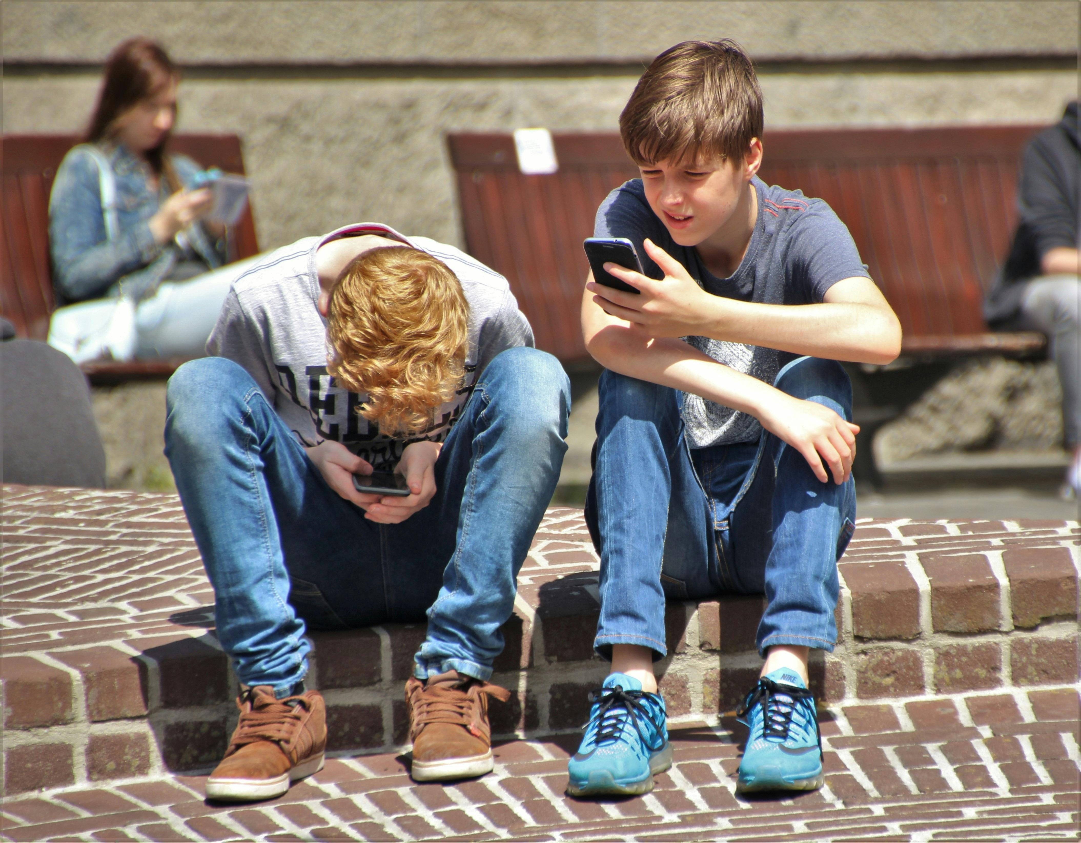
HELPING MY KIDS HANDLE SOCIAL MEDIA
Teach your sons and daughters to be pure.

Slide 14
HELPING MY KIDS HANDLE SOCIAL MEDIA
“TikTok is known for having the most addictive algorithm out there…When The Wall Street Journal created fake accounts on TikTok for 13-year-olds, they were almost immediately shown videos about drug use and paid pornography sites. A TikTok spokesperson told the Journal that the app doesn’t filter feeds to minors—they get the same videos as adults. Apple told TikTok to rate the app as 17+ on the App Store, but TikTok refused and kept it listed as 12+.”
Teach your sons and daughters to be pure.

Slide 15

HELPING MY KIDS HANDLE SOCIAL MEDIA
Help them grow comfortable being different from the world.

Slide 16
HELPING MY KIDS HANDLE SOCIAL MEDIA
Help them grow comfortable being different from the world.
“ ‘Teens… often feel ‘addicted’ and know that what they’re seeing is bad for their mental health but feel unable to stop themselves,’ concluded Meta’s internal research on Instagram. Meta found that the platform made body image issues worse for one in three teen girls. Academic research has also linked Instagram to eating disorders and body image issues…Nearly 6 out of 10 people—including Instagram users themselves—said they would prefer to live in a world without Instagram.”

Slide 17
HELPING MY KIDS HANDLE SOCIAL MEDIA
Help them grow comfortable being different from the world.
Snapchat “also has Snapstreaks, the number of days two users have snapped each other—a supposed measure of the strength of a friendship. When I ask middle and high school students how many do Snapstreaks, about a third of their hands go up. When I ask how many really like Snapstreaks, nearly all of the hands go down. It’s the classic addict’s narrative: They’re doing something even though they don’t really like it. They’re trapped.”

Slide 18
HELPING MY KIDS HANDLE SOCIAL MEDIA
Make sure your daughters and sons know how valuable they are.
Teach your sons and daughters
to be pure.
Help them grow comfortable being different from the world.

