Slide 1
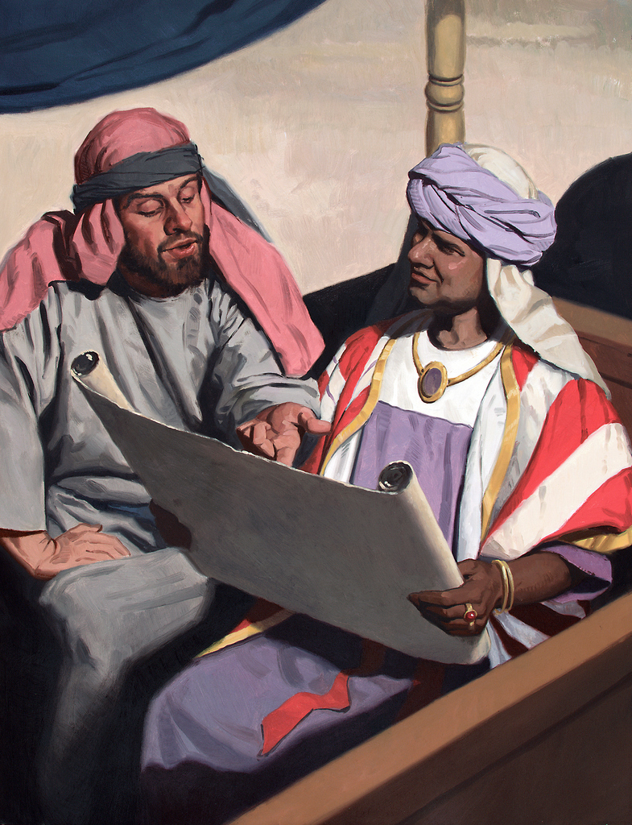

Slide 2
The Ethiopian Eunuch
This man was serious about serving God!
Acts 8:26-40

Slide 3
The Great Isaiah Scroll
(part of the Dead Sea Scrolls)

Slide 4
The Ethiopian Eunuch
This man was serious about serving God!
The OT mysteries are revealed in the NT.
Philip preached Jesus and the man wanted to be baptized.
Acts 8:26-40

Slide 5
“preaching the word... proclaiming Christ”
(8:4-5)
“preaching the good news about the kingdom of God and the name of Jesus Christ” (8:12)
“they were being baptized, men and women alike” (8:12)
“he preached Jesus
to him” (8:35)
“Look! Water! What prevents me from being baptized?” (8:36)

Slide 6
The Ethiopian Eunuch
This man was serious about serving God!
The OT mysteries are revealed in the NT.
Philip preached Jesus and the man wanted to be baptized.
The Holy Spirit was involved, but the man still had to make his own decision.
Acts 8:26-40

