Slide 2
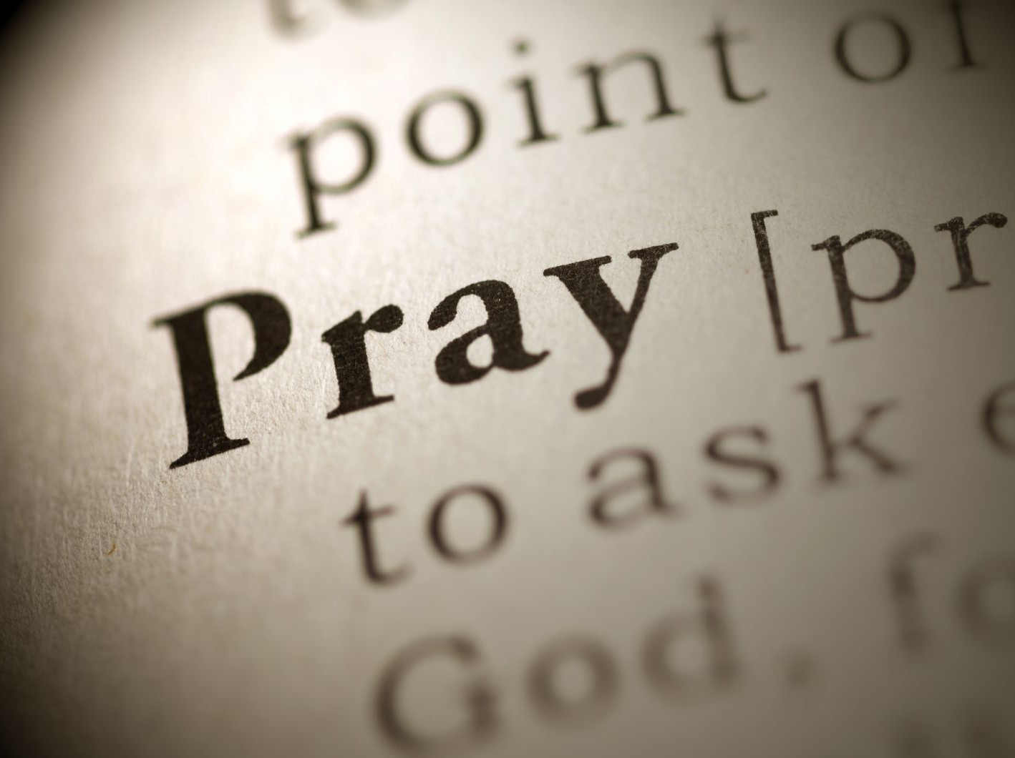

Slide 3

Women who prayed!
Anna the prophetess, Luke 2:37
Hanna, 1 Samuel 1:10

Slide 4
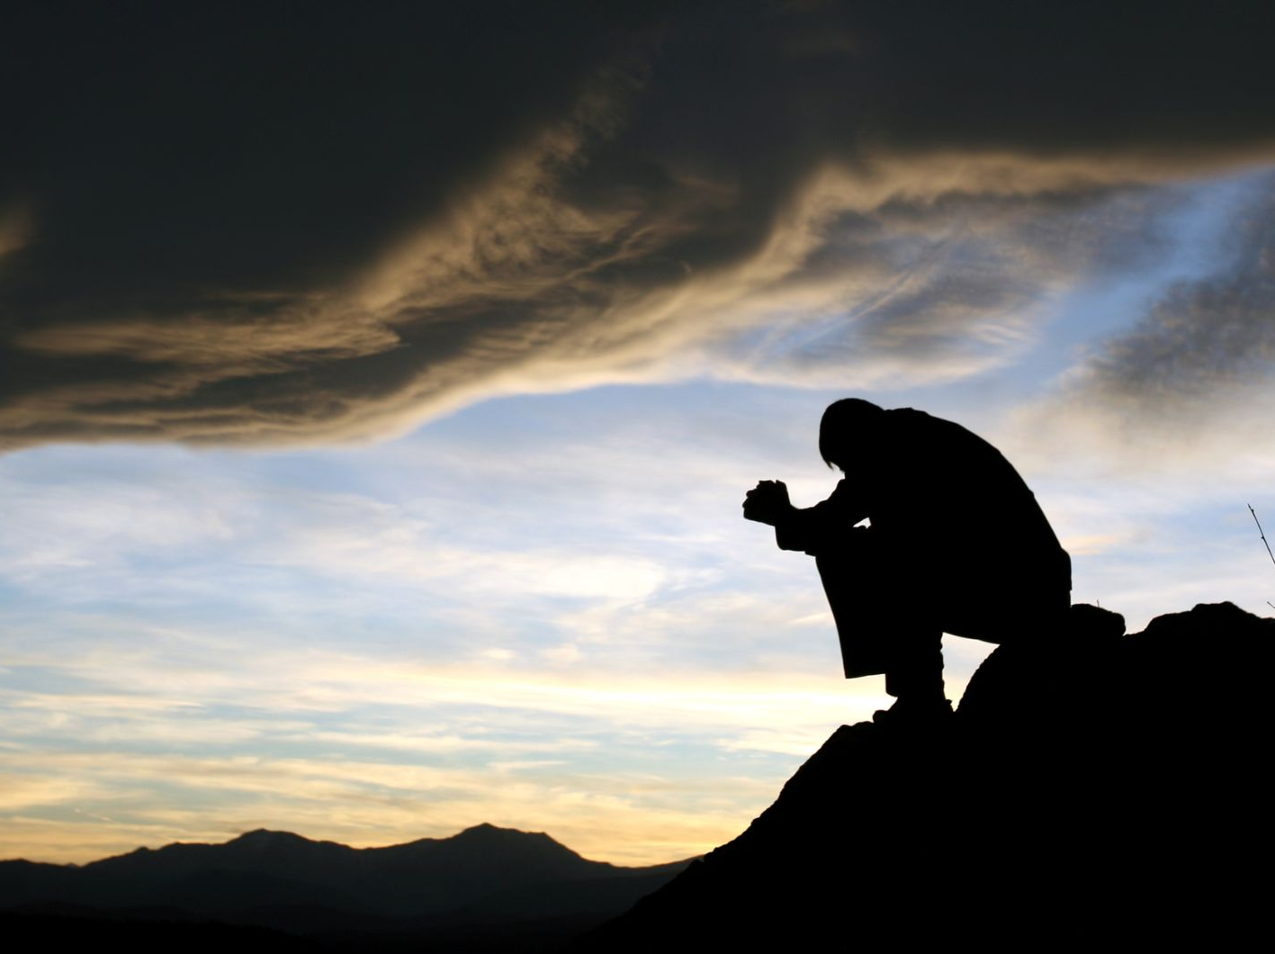
Men who prayed!
Jesus, Mark 1:34-35
Paul and Silas, Acts 16:25
Nehemiah, Nehemiah 1-2

Slide 5

This Way!
Matthew 6:9-13
Luke 18:1-7
1 Peter 5:7

Slide 6
Struggle in prayer
Colossians 2:1
Colossians 4:12-13
“Struggle, Labor, Wrestling, Always laboring fervently”
Put your Attention on your Intentions.
Sacrifice

Slide 7
Together
Acts 12:5
2 Chronicles 20:3-5

